Slide 1
Enhancing Binary Particle Swarm Optimization for Graph Coloring Problem.
A Research Proposal

Slide 2
Supervised by:
Presented by:
Mizanur Rahman
Student ID: 194053
Md Younos
Student ID: 194028
Md.Osman Goni
Student ID: 194054
Dr. Md. Jakirul Islam
Associate Professor
Department of Computer Science and Engineering
Dhaka University of Engineering & Technology, Gazipur.

Slide 3
Outline
Introduction
Aim of BPSO for GCP
Objective of BPSO for GCP
Methodology
Proposed Research Plan
Conclusion

Slide 4
Introduction
Graph coloring is a classic NP-hard optimization problem with applications in scheduling, resource allocation, and network design.
The Graph Coloring Problem is a challenging optimization task with practical relevance.

Slide 5
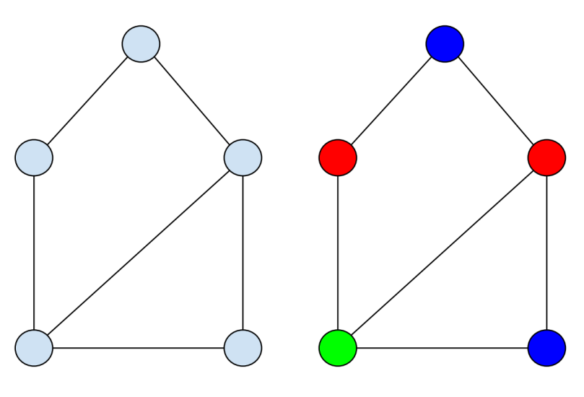
Introduction
The Graph Coloring Problem involves assigning colors to the vertices of a graph in such a way that no adjacent vertices share the same color. The objective is to minimize the number of colors used.
Figure: Non-colored and colored graph

Slide 6
Aim of BPSO for GCP
The research aims to develop novel strategies and modifications to the traditional BPSO algorithm, addressing the specific challenges posed by GCP.
To minimize the chromatic number.
Improving the efficiency and effectiveness of graph coloring solutions.

Slide 7
Objective of BPSO for GCP
To enhance the performance of Binary Particle Swarm Optimization (BPSO) algorithms for the Graph Coloring Problem (GCP).
To improve the binary encoding scheme used by BPSO to represent and manipulate graph coloring solutions more effectively.
To integrate a local search mechanism within the BPSO algorithm to refine solutions and enhance the convergence speed.
Evaluate and compare performance

Slide 8
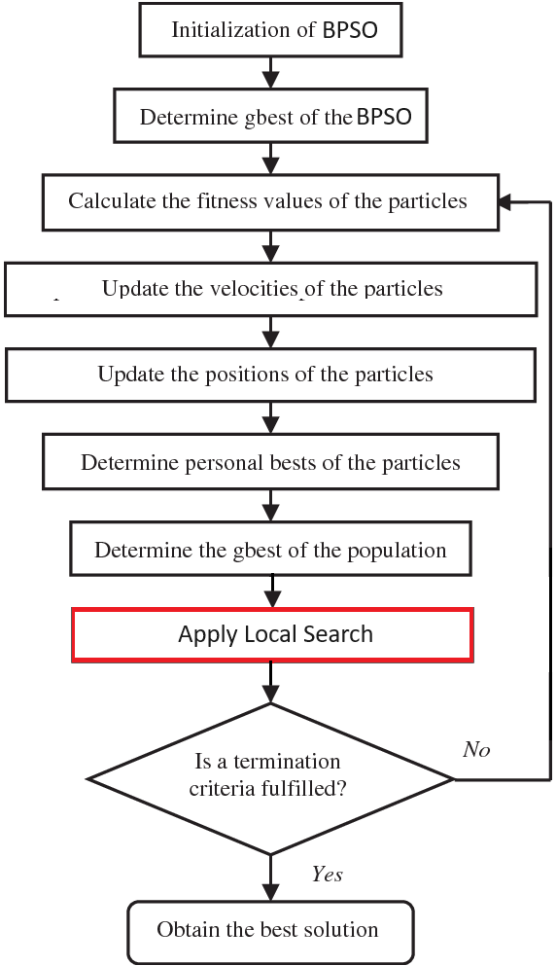
Methodology
Figure: The flowchart of the modified BPSO algorithm

Slide 9
Methodology
gbest represents the global best position, indicating the optimal solution found by any particle in the swarm. The algorithm utilizes gbest to guide particles towards promising regions of the solution space, enhancing convergence for effective optimization.
Fitness values are used to evaluate the quality of potential solutions. The algorithm aims to minimize the fitness, which corresponds to the chromatic number in graph coloring problems.
Evaluate the fitness of each particle using the binary position vector x_{i} and a defined fitness function.

Slide 10
Methodology
Initialize Particle Velocities: For each particle i, initialize a velocity vector v_{i} of length D with random values within a specified range.
Update Particle Velocities: Update the velocity of each particle we using the formula:
V_{i}(t+1) = w.v_{i}(t) + c₁.r₁.(P_{i}-X_{i}) + c₂.r₂.(g-x_{i})
_{Where,}
w is the inertia weight
c₁ and c₂ are acceleration coefficients.
r₁ and r₂ are random numbers in the range [0, 1].
p_{i} is the personal best position of particle i.
g is the global best position among all particles.

Slide 11
Methodology
Updating the position of particles in Binary Particle Swarm Optimization (BPSO) involves modifying their binary positions based on their current velocities.
formula:
x_{i}(t+1)=clip(x_{i}(t)+v_{i}(t+1))
Where,
clip(a) is a function that ensures the values of a remain within the valid binary range (0 or 1).
x_{i}(t) is the current binary position vector of particle i at iteration t.
v_{i}(t+1) is the updated velocity vector of particle i at iteration t+1.

Slide 12
Methodology
gbest of the population refers to the best solution or particle found among all the particles in the entire swarm at any given iteration. It represents the position in the solution space that has the lowest fitness (best objective function value) across the entire population.

Slide 13
Methodology
local search refers to a mechanism where individual particles explore the solution space in the vicinity of their current position to find better solutions.
For example, in a binary optimization problem, local search might involve flipping a few bits in the binary representation of a solution and checking if the new solution is better than the current one.

Slide 14
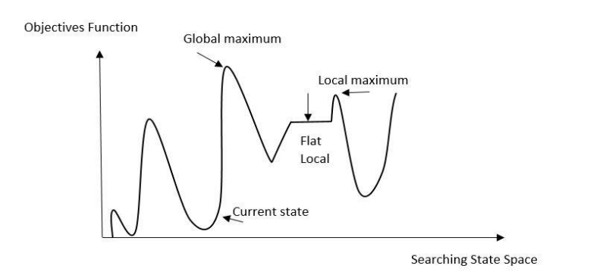
Methodology
Figure: Local search algorithm view
Apply a local search strategy to improve the present solution repeatedly through exploring its surroundings and selecting the best neighboring solution. The hill climbing algorithm is a common local search technique that finds the best neighboring solution that improves the objective function and repeats the process until a local optimum is obtained.

Slide 15
Proposed Research Plan
Stages of research | Jan-23 to Mar-23 | Apr-23 to Jun-23 | Jul-23 to Sep-23 | Oct-23 to Dec-23 | Jan-24 to Mar-24 | Apr-24 to Jun-24
Selection of topic
Literature review
Research methodology plan
Selection of the Appropriate Research Techniques
Analysis & Interpretation of Data
Findings and recommendations
Final research project

Slide 16
Conclusion
This proposal outlines a research plan to enhance Binary Particle Swarm Optimization for the Graph Coloring Problem. The proposed modifications aim to address the specific challenges of the GCP and contribute to the development of more effective optimization algorithms for combinatorial problems.

Slide 17
References:
T. R. Jensen and B. Toft, "Graph coloring problems," John Wiley & Sons, Oct. 24, 2011.
M. Kubale, "Introduction to computational complexity and algorithmic graph coloring," Gdanskie Towarzystwo Naukowe, 1998.
F. Mascia, "DIMACS Maximum Clique Benchmarks," IRIDIA - ULB (Université Libre de Bruxelles). Available: https://iridia.ulb.ac.be/~fmascia/maximum_clique/DIMACS-benchmark. Access date: Jul. 12, 2023.
S. Shah, "GCLIQUE: An Open Source Genetic Algorithm for the Maximum Clique Problem," Authorea Preprints, Sep. 26, 2023.
M. Hasan, M. R. Islam, and A. G. Mugdha, "Solving maximum clique problem using chemical reaction optimization," OPSEARCH, Jun. 20, 2023, pp. 1-37.
E. Pelofske, G. Hahn, and H. N. Djidjev, "Solving larger maximum clique problems using parallel quantum annealing," Quantum Information Processing, vol. 22, no. 5, May 16, 2023, pp. 219.
B. Q. Pinto, C. C. Ribeiro, I. Rosseti, and A. Plastino, "A biased random-key genetic algorithm for the maximum quasi-clique problem," European Journal of Operational Research, vol. 271, no. 3, Dec. 16, 2018, pp. 849-865.
D. B. Fontes, J. F. Goncalves, and F. A. Fontes, "An evolutionary approach to the maximum edge weight clique problem," Recent Advances in Electrical & Electronic Engineering (Formerly Recent Patents on Electrical & Electronic Engineering), vol. 11, no. 3, Sep. 1, 2018, pp. 260-266.

Slide 18


